Slide 1
Pricing, Packaging and Sizing for ICP
Charles Quincy

Slide 2

IBM Cloud Private Business Model
IBM Cloud Private is a platform that brings together tools and infrastructure for developers to build compelling, scalable applications for users
Value of Platforms: Platforms derive value from the amount of meaningful workload that is created and run on that platform
Rules: Quality workload on the platform → more users → more workloads → more
We capture value when customers deploy more workloads to ICP and our pricing metrics align to that
Users
Consume Applications
Developers
Build Applications
IBM Cloud Private

Slide 3
Key Terms for Pricing and Sizing
Term | Description
Virtual Processor Core | The ICP licensing metric; a VPC can be either a physical processor core, provided that the server is not partitioned for virtual machines or a virtual core assigned to a virtual machine
Over Subscription | When a VM is oversubscribed then more virtual cores are being made available to that VM then there are physical cores that VM sits on. This becomes a key consideration when the number of vCPUs made available to ICP is variable or greater than the physical CPUs made available to the VM.
vCPU/CPU | The technical manifestation of a VPC. The number of vCPUs/CPUs define the capacity made available for use by ICP.
“Made available” | A common phrase used in licensing VPCs. A vCPU/CPU made available to ICP means that ICP can schedule workload to that vCPU/CPU at any time during that workload’s maintenance life cycle. If a vCPU/CPU is made available to ICP for schedulable workloads, it is a chargeable component of ICP.
Master Node | A non-chargeable component of ICP; VPCs for vCPU/CPU made available to this component are not charged
Boot Node | A non-chargeable component of ICP; VPCs for vCPU/CPU made available to this component are not charged
Proxy Node | A non-chargeable component of ICP; VPCs for vCPU/CPU made available to this component are not charged
Worker Node | A chargeable component of ICP. Worker Nodes are where workloads run on ICP. Worker nodes oftentimes have a 1:1 to relationship to VMs (although not always) in a virtualized environment.
Cloud Foundry Cells | A chargeable component of ICP. Cloud Foundry Cells are where workloads run on ICP for Cloud Foundry.
Cloud Foundry Control Plane | A non-chargeable component of ICP

Slide 4
Understanding the ICP architecture
IBM Cloud Private only requires entitlements for WHERE workloads run (Worker Nodes or Cloud Foundry)
Workload runs on either 1) Worker Nodes or 2) Cloud Foundry Cells
Worker Nodes and Cloud Foundry Cells run on Virtualized or non-Virtualized infrastructure
Virtualized environments make vCPUs available to Workers and Cells; Non-Virtualized environments make CPUs available to Workers and Cells
Container
Container
Container
Container
Container
Container
Container
Container
Container
Container
Container
Container
Container
Container
Container
Container
Container
Master, Boot & Proxy
(4 vCPUs made available)
Worker Node #1
(6 vCPUs made available)
Worker Node #2
(4 vCPUs made available)
Cloud Foundry
Cells
(2 vCPUs made available)
Note:
Cloud Foundry control plane is a non-chargeable component of ICP (not diagramed because CF requires 16 cores for its control plane
ICP does not care how many containers are being deployed in the environment
VMWare or OpenStack
Core
Core
Core
Core
Core
Core
Core
Core
Core
Core
Core
Core
Core
Core
Core
Core
Socket 1
Socket 2

Slide 5
Understanding the VPC metric
Scenario: Customer has a virtualized environment on 2 Sockets, consisting of 8 cores each (total 16). They want the Cloud Native with 3 Worker nodes, with 3 Masters, 1 Boot and 3 Proxies. The environment is planned to run 10 containers and will be licensed on CapEx
Total Deal
10 VPCs
$64.8k
2 cores for the Masters, Boots, & Proxies
Worker Node #1
6 vCPUs made available
6 vCPUs = 6 VPCs
Worker Node #2
4 vCPUs made available
Oversubscribed on 2 cores
2 CPUs = 2 VPCs
Worker Node #2
4 vCPUs made available
Oversubscribed on 2 cores
2 CPUs = 2 VPCs
$0
$36k
$12k
$16.8k
Container
Container
Container
Container
Container
Container
Container
Container
Container
Container
Container
Container
Container
Container
Container
Container
Container
Master, Boot & Proxy
(4 vCPUs made available)
Worker Node #1
(6 vCPUs made available)
Worker Node #2
(4 vCPUs made available)
Cloud Foundry Cells
(4 vCPUs made available)
Note:
Cloud Foundry control plane is a non-chargeable component of ICP (not diagramed because CF requires 16 cores for its control plane
ICP does not care how many containers are being deployed in the environment
VMWare or OpenStack
Core
Core
Core
Core
Core
Core
Core
Core
Core
Core
Core
Core
Core
Core
Core
Core
Socket 1
Socket 2

Slide 6
Pricing & Packaging
IBM Cloud Private Cloud Native
IBM Cloud Private 2.1 in SQO
IBM Cloud Private Enterprise Edition
Application Modernization in SQO
Platform
Kubernetes
Core services
Cloud Automation Manager
HELM Catalog
NodeJS
WAS Liberty
Microservice Builder
Items in this box are available in Cloud Native AND Enterprise Edition
Deployed in Container
MQ Advanced
No additional bundled software
WebSphere Application Server Network Deployment
Deployed on VMs¹
API Connect Professional
Perpetual (D1URTLL)
$6,000/VPC
Monthly (D1US3LL)
$250/VPC/Month
Perpetual (D1VXCLL)
$20,400/VPC
Monthly (D1VXSLL)
$850/VPC/Month
¹VPCs for VMs are equivalent to VPCs for containers
Optional Components available to
Cloud Native & Enterprise Edition
Data Science Experience Local
Urban Code Deploy
Perpetual (D1VSHLL)
$16,800/Authorized User
Monthly (D1VSTLL)
$700/Authorized User/Month
Perpetual (D1VXQLL)
$1771/VPC
Monthly (DVYPLL)
$74/VPC/Month
Db2 Direct Advanced Edition
CAM for External Environments
Cloud Foundry*
Monthly (DVYMLL)
$365/VPC/Month
Perpetual (N/A)
Unavailable
Perpetual (D1VS9LL)
$1368/VPC
Monthly (D1VSPLL)
$57/VPC/Month
Perpetual (D1VS5LL)
$2400/VPC
Monthly (DVYMLL)
$100/VPC/Month
*Combined price of ICP Cloud Native + CF add-on part (1:1 relationship required)

Slide 7
Pricing & Licensing
IBM Cloud Private Cloud Native
IBM Cloud Private 2.1 in SQO
IBM Cloud Private Enterprise Edition
Application Modernization in SQO
Platform
Everything in this box is included in the license price for ICP Cloud Native and ICP Enterprise Edition
Deployed in Container
MQ Advanced
No additional bundled software
WebSphere Application Server Network Deployment
Deployed on VMs
API Connect Professional
Monthly (D1US3LL)
$250/VPC/Month
Perpetual (D1URTLL)
$6,000/VPC
Monthly (D1VXSLL)
$850/VPC/Month
Perpetual (D1VXCLL)
$20,400/VPC
Optional Components available to Cloud Native & Enterprise Edition
Everything in this box is available as an ADD-ON to ICP Cloud Native and ICP Enterprise Edition
*Combined price of ICP Cloud Native + CF add-on part (1:1 relationship required)

Slide 8
CAM Licensing; only license non-ICP environments
Scenario 1: Customer wants to leverage CAM to deploy ICP-based environments
CAM deploys on a worker node for $0. CAM binaries always included with ICP, so no extra download needed
CAM deploys ICP based environments at no additional charge
E.G. customer deploys an ICP Worker Node with 24 vCPUs made available to that Worker Node. Customer only pays the $250/VPC/Month price
IBM Cloud Private
ICP Control Plane
CAM Runtime
8 VPCs on a worker node not counted for the purposes of licensing
Worker node in ICP managed by CAM
Charged at standard ICP rate
Managed to
by CAM
Scenario 2: Customer wants to leverage CAM to deploy environments outside of ICP
CAM deploys on a worker node for $0. CAM binaries always included with ICP, so no extra download needed
Customer licenses ICP at $57/VPC for the non-ICP environment deployed and managed by CAM
Managed to
by CAM
Multi-Cloud or on premise deployments managed by CAM
$57/VPC/Month
$1368/VPC
> The requirement for 1 VPC is in the license terms. Because CAM for External Environments has a licensing dependency on ICP, then we require at least 1 VPC of ICP with each CAM for External Environments deal. > This will also cover the platform support that will be required for the running of CAM.
Note: all prices are per VPC per month

Slide 9
How to price Optional add-ons to ICP Cloud Native or Enterprise Edition
Worker Node #1
2 Db2 Containers, using 2 vCPU
Db2 sits on 2 vCPU of ICP
2 vCPUs of Db2 = $730/month
2 vCPUs of ICP = $500/month
Worker Node #1
4 Liberty containers
4 vCPUs made available
4 CPUs = 4 VPCs
ICP requires optional software to be licensed in ADDITION to VPCs for ICP
Example sizes an environment with 6 VPCs made available to ICP and 2 VPCs to Db2
4 vCPUs are made available to ICP to 4 Liberty containers (doesn’t necessarily need to be 1:1 relationship between vCPUs and containers)
2 vCPU are made available to ICP to 2 Db2 containers
Db2 is sized at 2 vCPU
Db2 is only available as a monthly license; other optional components can be licensed as either monthly or perpetual
2 cores for the Masters, Boots, & Proxies
$1k/month
$1230/month
$0
Total Deal
6 VPCs of ICP
2 VPCs of Db2
$2230/month
Liberty
Liberty
Liberty
Liberty
Db2
Db2
Master, Boot & Proxy
(4 vCPUs made available)
Worker Node
(6 vCPUs made available)
VMWare
Core
Core
Core
Core
Core
Core
Core
Core
Socket 1

Slide 10
BYOL: Bring your own license tracking and monitoring
Worker Node #1
Customer brings 140 PVUs of MQ
Cores available to ICP are rated 70 value units, so 2 VPCs are required to run MQ
2 VPCs of ICP are used to run MQ
Worker Node #1
4 Liberty containers
4 vCPUs made available
4 CPUs = 4 VPCs
ICP utilizes Product Insights for license management, which only tracks VPCs
If a customer wants to bring a PVU license over to ICP
They must calculate how many VPCs are needed to run the PVU based workload
Calculating VPCs requires taking the total PVUs and dividing by the Value Units. The result is the number of VPCs
VPCs x Value Units = PVUs
2 cores for the Masters, Boots, & Proxies
ICP DOES NOT track PVUs; VPCs per workload and VPCs for ICP are tracked
Liberty
Liberty
Liberty
Liberty
MQ
MQ
Master, Boot & Proxy
(4 vCPUs made available)
Worker Node
(6 vCPUs made available)
VMWare
Core
Core
Core
Core
Core
Core
Core
Core
Socket 1

Slide 11
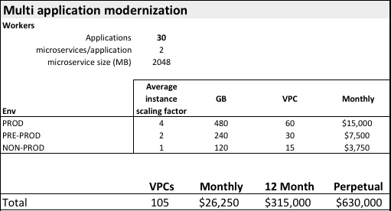
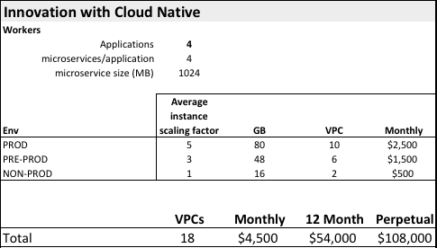
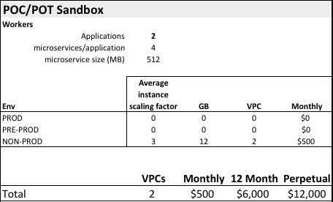
Sizing and pricing on three ICP use cases
Modernization Use Case
Net-New Cloud Native Use Case
Trial Use Case
“Lift and Shift” of an existing WAS-based application
Minimal re-factoring is expected; few number of microservices
Scaling factor is the number of instances the application's microservices will need to scale up to so service the load
For Cloud Native applications there will be many microservices per application.
Assessment of the customers cloud maturity and complexity of a sample application will provide an indication.
Scaling factor is the number of instances the application's microservices will need to scale up to so service the load
Minimum configuration to get a customer reasonably comfortable with building and deploying applications with ICP.
Scaling factor is the number of instances the application's microservices will need to scale up to so service the load

Slide 12
4 Sales Plays to get customers started
 | ICP Cloud Native for New Apps (applies to D1URTLL & D1US3LL) | ICP Cloud Native for Lift & Shift (applies to D1URTLL & D1US3LL) | ICP Cloud Native Sandbox (applies to D1URTLL & D1US3LL) | ICP Enterprise Edition (applies to D1VXCLL & D1VXSLL)
Program Description | For customers looking to get started building cloud native applications on a Kubernetes platform | For customers looking to 'lift and shift' an existing J2EE application into a container | For customers looking to experiment with Kubernetes and containers in a supported environment | For customers looking to experiment with Enterprise Edition in a supported environment
# of Applications | 2 | 2 | 2 | 2
# of Microservices | 4 | 8 | 8 | 4
VPCs | 8 | 10 | 2 | 4
Discount | 25% | 25% | 25% | 39%
Annual Price* | $18,000 | $22,500 | $4,500 | $25,000
Perpetual Price | $36,000 | $45,000 | $9,000 | $50,000
-or-
-or-
-or-
-or-
-or-
-or-
-or-
-or-
*Minimum of 12 months required on Monthly

Slide 13
FAQ
How is ICP Cloud Native and Enterprise Edition licensed?
ICP is IPLA software licensed either monthly or as a standard perpetual license (License + S&S). Monthly part numbers allow for customers to ramp up usage over the contract term. Perpetual and monthly can be included on the same bid.
How does licensing on Enterprise Edition work?
Enterprise Edition packages ICP Cloud Native, WAS ND, API Connect, and MQ Advanced. Customers must have sufficient entitlements (VPCs) in order to run the bundled software. For example, if a customer could run all 4 bundled packages on a single vCPU, then they would only require 1 VPC entitlement for Enterprise Edition. Further, if a customer makes available 1 vCPU to each of the 4 bundled packages, then 4 VPC entitlements would be required.
Isn’t Db2 Warehouse/DashDB Local supported on ICP?
Yes! Customers can still purchase ICP for Data Science which is a bundle of Db2 Warehouse and ICP Cloud Native. The bundle works in the same way as the Enterprise Edition.
Is there a discount floor for ICP?
Yes. ICP Cloud Native and Enterprise Edition have a strict 25% discount floor on entitled. We will reject all bids that show a higher discount off entitled and require significant justification.
Can I mix and match Enterprise Edition and Cloud Native?
Absolutely.
Can customers bring their own licenses?
Yes. Customers need to ensure they have enough ICP capacity licensed in order to run their workloads, but they are within their entitled rights to deploy their existing licenses on ICP. Please note, that customers will have to adhere to the license requirements of what they deploy on ICP.

Slide 14
IBM Cloud Private Business Model (Revisited)
IBM Cloud Private is a platform that brings together tools and infrastructure for developers to build compelling, scalable applications for users
Value of Platforms: Platforms derive value from the amount of meaningful workload that is created and run on that platform
Rules: Quality workload on the platform → more users → more workloads → more
We capture value when customers deploy more workloads to ICP and our pricing metrics align to that
More Quality workload with a great user experience
More Users
Incents more developers to build and deploy new and existing workloads on ICP
More VPCs Sold
Creates more demand for additional workloads
Users
Consume Applications
ICP Platform Business Model
Developers
Build Applications
IBM Cloud Private

Slide 15
Back up

Slide 16

What is in the HELM Catalog
Core Operational Services
Open Source
IBM Software
Monitoring Service
Prometheus or BYO
Logging Service
Elk or BYO
Metering Service
Product Insights
Security
Identify and Access Management
LDAP integration & RBAC
Vulnerability Advisor (beta)
Toolchains & Runtimes
Jenkins
Apache Tomcat Open Liberty
Messaging
RabbitMQ
Data Services
MongoDB
PostgreSQL
Redis
Clustering
Galera
Http Servers
Nginx
Terminal Access
Web Terminal
Toolchain & Runtimes
IBM Microservice Builder
IBM WebSphere Liberty
IBM SDK for Node.js
Messaging
IBM MQ Advanced for Developers IBM MQ Advanced
Data Services
IBM Db2 Dev-C
IBM Data Server Manager
IBM Db2 Direct Advanced Edition / AESE
with Data Server Manager*
IBM Db2 Warehouse Dev-C
IBM Db2 Warehouse Enterprise
IBM Cloudant Developer Edition
Multi-cloud Management
IBM Cloud Automation Manager
Data Science
IBM Data Science Experience Developer Edition
IBM Data Science Experience Local*
Integration
IBM Integration Bus for Developers
IBM Integration Bus¹
IBM DataPower Gateway for Developers
IBM DataPower Gateway Virtual Edition
App Modernization Tooling
IBM Transformation Advisor
Monitoring
IBM Cloud Application Performance Management for DevOps (beta)
HPC
IBM Spectrum LSF Community Edition
+
Develop or bring your own…
Self written, community and open source compatible with Kubernetes 1.7

Slide 17

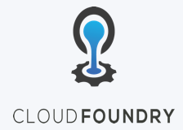
What is in the CAM Catalog & Included with Cloud Foundry
Extend workload provisioning with Cloud Automation Manager
Template driven provisioning of private and public cloud infrastructure: Bare-metal servers, VMs, cloud native services & complex application stacks
Open Source Catalog ⁽¹⁾
Enterprise Catalog ⁽¹⁾
MEAN stack – VMware, Azure, AWS, IBM Cloud
LAMP stack – VMware, Azure, AWS, IBM Cloud
Node.js – VMware, IBM Cloud
Strongloop – VMware, IBM Cloud
MariaDB - VMware
MongoDB – VMware, IBM Cloud
MongoDB Strongloop 3 tier – VMware, IBM Cloud
Virtual Servers with SSH key – AWS, IBM Cloud
Apache HTTP Server - VMware
Apache Tomcat - VMware
IBM DB2 EE (v10.5 & v11.1) - VMware
IBM MQ (v8 & v9) - VMware
IBM WebSphere Application Server ND (v11.1) - VMware
IBM WebSphere Liberty (v17) - VMware
IBM HTTP Server (v8.5.5, v9) - VMware
Oracle DB Enterprise (v12c) - VMware
Oracle MySQL (v5.7) - VMware
IBM Buildpacks
WebSphere Liberty
Runtime Buildpacks
Node.js
Swift
.Net
Automation content available with IBM Cloud Private purchase. Product licenses must be purchased separately or BYOL. See pricing and packaging for more information.
Bring your own Buildpacks
Add additional open source or private
+
+
Community Templates
Bring your own templates
Hashicorp Terraform Registry
Self written, IBM Cloud Schematics, etc

Slide 18
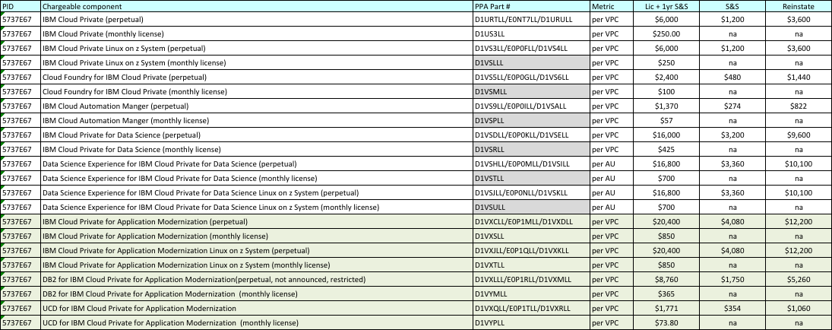
Part numbers and Prices

